Slide 1
Impossible. Possible.
Introducing new Transitions® Vantage™ lenses with variable polarization
Notes:
I’m here today to introduce the NEW Transitions Vantage lenses – the revolutionary everyday adaptive lenses designed to both darken and polarize upon UV exposure to deliver noticeably crisper, sharper vision, even in the brightest outdoor glare.
You’ll learn today how Transitions Vantage lenses not only adapt to changing light but also increase polarization as they darken, optimizing the angle at which light reaches the eyes to help control glare and light scatter.

Slide 2
Light = Vision
By controlling light we can enhance vision in powerful ways
Notes:
As you know light is the key to vision; it stimulates our senses and makes all things visible.
By controlling the … Amount of light … Direction of light … and Color of light that enters the eye, we can enhance vision in powerful ways.

Slide 3
Light controlling technologies
Tinted lenses
Polarization
Adaptive photochromic lenses
Anti-reflective coating
Mirror coatings
Notes:
A you know, there are many technologies that help enhance vision by controlling the amount of light entering the eye.
Some of these are also used for cosmetic reasons.
But right now, only one of these technologies actually adjusts with the amount of light … photochromics.

Slide 4
Photochromics
(photo=light, chroma=color)
Light energy
C
H
3
C
H
3
C
H
C
H
N
N
3
3
N
N
O
N
+
C
H
3
N
O
Heat
C
H
Two halves at different angles
Colorless
3
One large plane
Colored
Notes:
For more than 20 years, our core competency at Transitions Optical has been photochromics.
The definition of photochromics is a light-induced, reversible change in color.
A photochromic lens contains millions of photochromic molecules.
In the colorless state, these molecules consist of two smaller halves held out of plane from one another (at different angles).
In other words, when the lenses are clear, the two halves of the photochromic molecule are perpendicular to each other.
(Click to build)
When exposed to light energy, a chemical bond breaks and the molecule rearranges itself into one flat plane that absorbs in both the UV and the visible portion of the light spectrum – the molecule now has color.
In other words, UV light changes the shape of the photochromic molecules and the lenses darken.
(Click to build)
When the light energy is taken away, heat reforms the bond, and the lenses go back to clear.

Slide 5
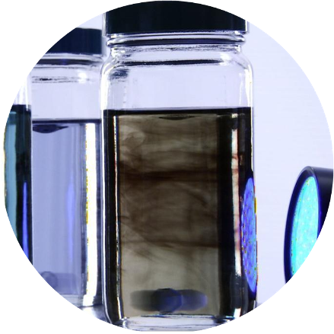
Technology continues to evolve
80 researchers and developers
New, more complex photochromic molecules
Over 2500 photochromic dyes
N
N
O
O
O
Notes:
What many people do not realize is that photochromic chemistry continues to evolve.
By focusing only on superior light management (photochromic technology), we can dedicate significant R&D and commercial resources.
Transitions Optical has 80 researchers and developers who are constantly working on the next innovation in light management.
Over the years, they have created new, more complex photochromic molecules and today have over 2,500 photochromic dyes.

Slide 6
Performance factors
AR
COMPATIBILITY
To achieve desired performance dyes are blended
Balancing all factors creates superior wearer experience
ACTIVATION BEHIND WINDSHIELD
DARKNESS
BLOCKS
100% UV
COLOR STABILITY
CLARITY
SPEED
CHOICE & AVAILABILITY
TEMPERATURE
DEPENDENCE
Notes:
These photochromic dyes are blended to achieve the desired performance characteristics.
There are many factors to consider in photochromic performance (shown).
Most people focus on indoor clarity, outdoor darkness and speed – but that is not always what patients want.
Understanding how to balance the desired properties to meet the visual needs of different patient groups provides a superior wearer experience.
We know this, not just from testing in the laboratory, but from real-world, real-wearer experience.
We are continuing to push the boundaries of photochromic technology and are asking the questions that break the paradigm of what is expected…

Slide 7
What if the lenses didn’t just get dark?
Going beyond “clear, dark, fast”
Notes:
We are looking beyond the traditional photochromic performance factors to the next breakthrough technology.
And today we have it…

Slide 8
Variable polarization, the next first
Notes:
Transitions® Vantage™ lenses.
“Variable polarization” is the next first, the next breakthrough technology.

Slide 9
Conventional photochromics vs. Transitions® Vantage™ lenses
Conventional photochromic lenses
Indoors
Darkens Outdoors
Virtually Clear Indoors
Darkens & Polarizes Outdoors
Notes:
As you know, conventional photochromics go from clear to dark.
A Transitions Vantage lens starts out virtually clear indoors and non polarized; and outdoors, the lens darkens and polarizes.
This means, Transitions Vantage lenses will have a variable level of polarization depending on the amount of UV exposure – the darker the lens, the more polarization there is. The lighter the lens, the less polarization there will be.

Slide 10
Adds another dimension
CLARITY
Breaks the paradigm that clear to dark is the only variable
SPEED
ACTIVATION BEHIND WINDSHIELD
BLOCKS
100% UV
COLOR STABILITY
POLARIZATION
AR
COMPATIBILITY
DARKNESS
CHOICE & AVAILABILITY
TEMPERATURE
DEPENDENCE
Notes:
Polarization adds another dimension to photochromic performance.
And breaks the paradigm that clear to dark is the only photochromic variable.
So why add polarization to the mix?

Slide 11
The next level of glare protection for everyday lenses
Polarization = added glare protection
Notes:
We’ve added polarization because darkness alone does not equal protection from all types of glare.

Slide 12
Four types of glare
Distracting
Glare
Discomforting Glare
Disabling Glare
Blinding
Glare
Eliminated by photochromics, tint, polarization
Eliminated by clear or photochromic lenses with AR
Eliminated by photochromics
Eliminated by polarization
WITH GLARE
WITHOUT GLARE
Notes:
The optical industry has defined four types of glare:
(Click to build)
Distracting glare: Caused by light reflecting off the front and/or backside of ophthalmic lenses and by car headlights and streetlights at night, it can be annoying and can cause eye fatigue. (Click to build) Anti-reflective lenses are effective in eliminating distracting glare.
(Click to build)
Discomforting glare: Caused by bright sunlight, it can exhibit in any weather or intensity of light, particularly when moving from one environment to another. It can cause eye fatigue and squinting. (Click to build) Photochromic lenses can help eliminate discomforting glare. (NOTE to speaker, sunglasses or tinted lenses are not considered a solution because they are too dark.)
(Click to build)
Disabling glare: Caused by intense light, such as facing into the sun, it can block vision and is potentially dangerous, such as when driving a vehicle. (Click to build) Fully activated photochromic lenses, lenses with a high percentage tint density, or polarized lenses all help cut disabling glare.
(Click to build)
Blinding/reflected glare: Caused by light that is reflected off of smooth, shiny surfaces, it can block vision. (Click to build) Polarized lenses reduce blinding/reflected glare.

Slide 13
Four types of glare managed by Transitions Vantage with AR
 | Distracting Glare | Discomforting Glare | Disabling Glare | Blinding Glare
Transitions Vantage lenses with AR |  |  |  | 
Photochromic lens with AR |  |  | 
Clear lenses with AR | 
Sun lenses |  |  | 
Polarized sun lenses |  |  |  | 
EVERYDAY EYEWEAR
SUNWEAR
Notes:
With AR added, Transitions Vantage lenses help to manage all four types of glare. There isn’t another everyday lens that addresses all four types of glare.
Polarization provides added glare protection over and above traditional photochromic lenses.
In addition to blocking excessive light, polarization optimizes the angle at which light reaches the eyes to help control glare.
Let’s take a closer look at how polarization works.

Slide 14
Polarization
Light reflected off a flat surface causes glare
Polarized filters block reflected light
Notes:
Waves of light from the sun radiate outward in all directions and planes.
When light hits a horizontal surface, such as a flat road or smooth water, the light is reflected as a plane wave, causing glare.
So instead of light being radiated in all directions, there is more light reflected horizontally.
(Click to build)
Polarized lenses contain a special filter that blocks light reflected in the horizontal plane.
A common analogy is to think of a polarized film like a venetian blind.

Slide 15
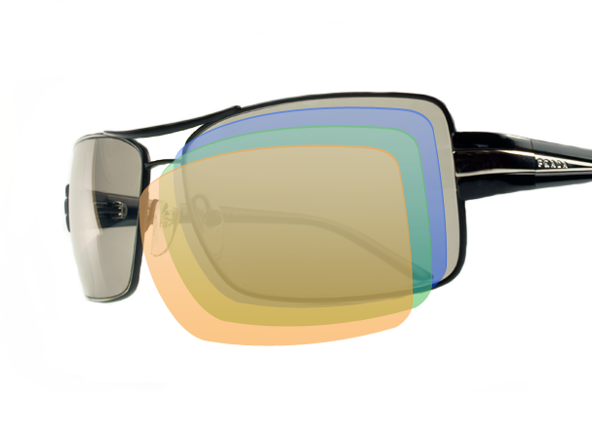
Polarization technology
Uses polarized film
Is a fixed tint
Is only used for sun lenses
Notes:
Polarized sunglasses are traditionally manufactured using a polarized film.
There are different methods for applying this film:
Older products use films that are glued to the front of the lens.
New techniques sandwich (or embed) the film between layers of the lens,
Or combine the filter with the lens material when it is in its liquid form.
Regardless of the technique, all of the traditional technologies use a film.
Because of the polarization film that is used, all traditional polarized lenses are tinted and have fixed polarization.
This means that all traditional polarized lenses are considered sun lenses.

Slide 16
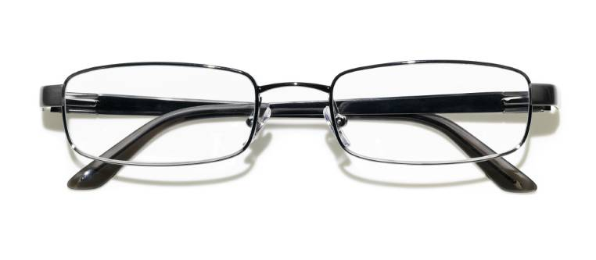
Transitions Vantage lenses
New unique proposition
Variable tint
+
Variable polarization
Simulation of performance, lines are only to illustrate light being blocked.
Notes:
Transitions Vantage lenses offer a new, unique proposition – offering both variable tint and variable polarization.
This changes some assumptions most of us have about polarization.

Slide 17
Breaks “the polarization paradigm”
Conventional understanding of polarization
Transitions Vantage lenses break the paradigm
A virtually clear lens cannot be polarized
A virtually clear lens that polarizes outside
A polarized lens is dark = sunglasses
Polarization that becomes virtually clear = lens worn everyday
Polarized lenses are “fixed by nature”
Polarization is now dynamic
Polarization = film
Photochromic dyes that activate and orient to the proper angle
Notes:
Conventional understanding of polarization as we know it today is that:
Clear lenses cannot be polarized.
Polarized lenses are dark, which means they are sunglasses.
Polarization of a lens is fixed.
Polarized lenses use a film.
(Click to build)
Transitions Vantage lenses break the polarization paradigm, now:
A clear lens that polarizes outside,
A polarized lens that becomes virtually clear can be worn everyday, both indoors and outdoors,
Polarization is now dynamic,
You don’t need a film to achieve polarization. This technology is something completely new. It uses photochromic dyes that activate and orient t the proper angle to create polarization.
So how do they work?

Slide 18
Transitions® Vantage™ lens technology
Conventional photochromic molecules darken in random patterns
Transitions Vantage lens molecules darken + horizontally align to create polarization
Notes:
As we discussed, conventional photochromic lenses are made up of millions of photochromic molecules.
These molecules darken in random patterns, creating an even tint.
(Click to build)
Transitions Vantage lenses use technology that is different than photochromics and polarization as you know them today.
The photochromic dyes in Transitions Vantage lenses not only darken, but they also align to create polarization.
This technology does not use a polarized film.
And while the photochromic molecules still change shape when exposed to UV light, they also change alignment.

Slide 19
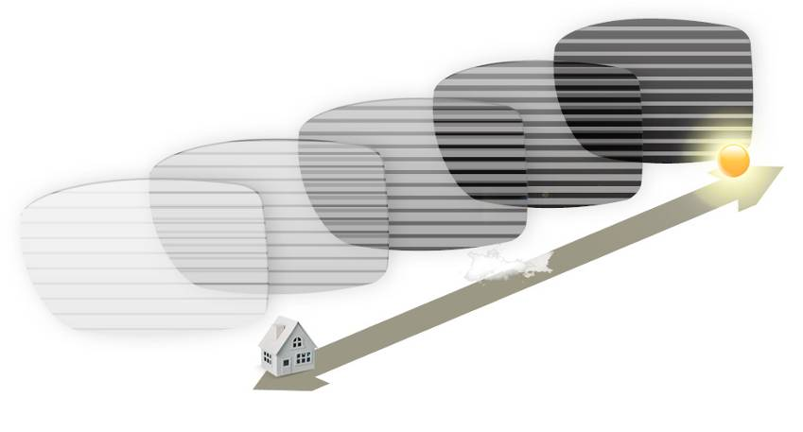
Variable polarization
The next first
Lines are only to illustrate light being blocked.
Notes:
With variable polarization the lenses not only adapt to changing light by darkening, but also by increasing in polarization.
This means that Transitions Vantage lenses will have a variable level of polarization efficiency depending on the amount of UV exposure – the darker the lens, the more polarization efficiency there is. The lighter the lens, the less polarization there will be.
As the lenses start to darken and polarize wearers start to experience the benefits of Transitions Vantage lenses.

Slide 20
Wearer experience
counts
Notes:
We have found in our research that performance numbers aren’t as important as the wearer experience.
Transitions Optical has created and developed proprietary measurement and testing tools and techniques that have set the standard for the photochromic category – but we will be the first to tell you that trying to compare light transmission numbers isn’t going to give you the full story – there are just too many factors that impact how the wearer actually sees.
For example, if you were to compare the darkness of Transitions VI lenses to Transitions Vantage lenses you would find that by the numbers Transitions VI lenses are darker. However, as you are about to see consumers perceived Transitions Vantage lenses to be darker than Transitions VI lenses…

Slide 21
Wearer experience testing
Real world, real conditions
Notes:
The numbers don’t tell the whole story, there is no one measurement that takes into account the benefit of both darkness and polarization.
This is why we don’t just test our products in controlled lab settings, we also use consumer wearer testing across a variety of conditions (temperature and lighting) to ensure consistent performance – and an enhanced wearer experience.

Slide 22
Wearer test methodology
Transitions® Vantage versus Transitions® VI lenses
130 wearers
Even mix of photochromic and clear lens wearers
Blind test
Half started with Transitions Vantage, then switched to Transitions VI
Half started with Transitions VI, then switched to Transitions Vantage
Only variable was: photochromic performance
Independent study in Florida – May/June
Notes:
We conducted a wearers test to compare Transitions Vantage lenses to Transitions VI lenses.
The study included 130 wearers.
Representing an even mix of photochromic and clear lens wearers.
It was a blind test.
Half of sample started with Transitions Vantage lenses, then switched to Transitions VI lenses.
The other half started with Transitions VI lenses, then switched to Transitions Vantage lenses.
The only variable in the study was photochromic performance.
It was conducted by an independent research company in Florida – May/June 2011.

Slide 23
A satisfying indoor experience
Among all wearers
Satisfaction with Indoor Vision = 76%
Satisfaction with Clarity Indoors = 80%
9 out of 10 photochromic wearers were satisfied with their indoor experience
Source Transitions Optical: Wearer Test – June 2011 – Top 2 Boxes (Most Significant)
Notes:
Among all wearers (clear lens and photochromic lens wearers) satisfaction with indoor vision and the level of clarity was very high.
Overall 9 out of 10 photochromic wearers were satisfied with their indoor experience.

Slide 24
Transitions Vantage lenses preferred on key polarization benefits
Transitions VI lenses
Provide sharp image definition outdoors when the weather is sunny
Crispness of vision outdoors when sunny
Enhance visual contrast when outdoors in sunshine
Transitions Vantage lenses
Source Transitions Optical: Wearer Test – June 2011 – Preference
Notes:
Outdoors, on all of the key polarization benefits – visual contrast, crispness of vision and sharpness of vision – Transitions Vantage is preferred over Transitions VI lenses.
Remember I said that if you just look at the numbers Transitions VI lenses are darker, however you can see that when out in the sun darkness alone doesn’t tell the whole story.
These results show that the added benefit of polarization does make a difference to the wearer experience.

Slide 25
Superior benefits outdoors
Among all wearers
Satisfaction with Outdoor Vision = 77%
Satisfaction when Sunny = 73%
8 out of 10 patients were satisfied with the outdoor experience as well as the indoor clarity of Transitions Vantage lenses
Source Transitions Optical: Wearer Test – June 2011 – Top 2 Boxes (Most Significant)
Notes:
Looking at the response to Transitions Vantage lenses you can see that the polarization benefits provide superior consumer benefits outdoors.
8 out of 10 of all the consumers who participated in the study were satisfied with the outdoor experience as well as the indoor clarity of Transitions Vantage lenses.

Slide 26
Providing a unique, new combination of benefits
Agreement after wearing Transitions Vantage lenses
Different from lenses you wore in the past
Provides sharp image definition outdoors in sunny weather
Provides crisp vision in sunny conditions outdoors
Enhances clarity of vision outdoors when sunny
Source Transitions Optical: Wearer Test – June 2011 – Top 2 Boxes (Most Significant)
Notes:
People that wore Transitions Vantage lenses experienced something they had never experienced before.
As you can see crisper, sharper vision aren’t just marketing words we’ve made up.
Knowing there is research to back up these claims, you should have the confidence you need to recommend and discuss the benefits of Transitions Vantage lenses with your patients.

Slide 27
How Transitions Vantage lenses fit in the Transitions family of products
Notes:
Now that we have shown you the wearer test results comparing Transitions Vantage with Transitions VI lenses you might be wondering how Transitions Vantage lenses fits into the current Transitions Optical offering.

Slide 28
No pair of eyes is alike
Morning to night, weekend to day, person to person
Notes:
As you know, no pair of eyes is alike.
Vision needs to change … from morning to night … from work to play … from weekday to weekend … and from person to person.
You know that today’s eyecare professional must meet the needs of all their patients … and the multiple needs of each patient.

Slide 29
Unparalleled choice
Material
Design
Everyday
Notes:
Because of this, we’ve always provided unparalleled choice in materials and designs available as a Transitions lens.
Even beyond material and design we offer choices among everyday lenses including Transitions VI lenses, Transitions XTRActive lenses, and now, Transitions Vantage lenses.
These lenses are all worn in place of ordinary, clear lenses.
They are all designed to be worn indoors and outdoors.
They all adapt to changing light for more comfortable vision, while protecting the eyes from UV.
So how are they different?

Slide 30
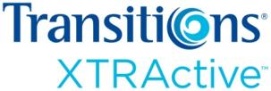
Each product has a different set of attributes
Outdoor
darkness
Behind the
windshield activation
Fade back
Variable Polarization
Indoor
clarity
Polarization
Notes:
Each product has a different set of attributes.
(Click to build)
Transitions VI lenses offer indoor clarity, widespread availability and excellent fade back – they offer the optimal balance between outdoor darkness, indoor clarity and fade back speed.
(Click to build)
Transitions XTRActive lenses are designed to be XTRA dark outdoors and have some activation behind the car windshield. They are also designed to have a comfortable indoor tint.
(Click to build)
Transitions Vantage lenses of course have the added benefit of variable polarization.
These different attributes mean different patient benefits…

Slide 31
Delivering a different set of benefits
Clear, dark, fast
Comfortable tint, darkest, BWS
The only adaptive lens that polarizes
Attributes
Most balanced everyday lens
Superior darkness
Crisper, sharper vision outdoors
Benefits
Notes:
Because they offer clarity, darkness and speed… (Click to build) … Transitions VI lenses are the MOST BALANCNED EVERYDAY LENS.
Transitions XTRActive lenses provide … (Click to build) … SUPERIOR OUTDOOR DARKNESS.
As the only adaptive lens that also polarizes, Transitions Vantage lenses provide … (Click to build) … CRISPER, SHARPER VISION OUTDOORS.

Slide 32
Desirable to different patients
Clear, dark, fast
Slight tint, darkest, BWS
The only adaptive lens that polarizes
Attributes
Most balanced everyday lens
Superior darkness
Crisp, sharp vision outdoors
Benefits
Patient
profile
Everyday activities
Wearers who are outdoor driven
Looking for more
Notes:
When you think about your patients and the product attributes and benefits that would be desirable to them, you can see a different patient profile emerge for each everyday lens offering,
(Click to build)
Transitions VI lens wearers desire a clear lens indoors and are looking for the best all around lens for their everyday activities.
(Click to build)
Transitions XTRActive lens wearers are going to be focused on outdoor activities.
(Click to build)
While Transitions Vantage lens patients are the ones looking for something more, they are your patients that are interested in feature-rich products.

Slide 33
More features + benefits = willingness to invest more
Notes:
Since the Transitions Vantage lens patient is looking for more features and benefits, they are also going to be willing to invest more in the product.

Slide 34
How to recommend Transitions Vantage lenses
Notes:
So how should you dispense/recommend Transitions Vantage lenses?
First you need to determine what your patient’s needs are.

Slide 35
Transitions Vantage lens patients…
Place high importance on vision enhancement outdoors
Want the latest technology
Are looking for feature-rich everyday lenses
Polarized sunglass wearers
Existing photochromic wearers
Notes:
The type of patient who would typically be interested in Transitions Vantage lenses would also be…
(Click to build)
A person who is interested in the latest technology – these are your patients that are always the first to have new technology; the latest iPhone, the newest gadget.
(Click to build)
They may also be someone who recognizes the value in premium features for their everyday eyewear; they may even already be a premium or photochromic lens wearer.
(Click to build)
Or they are someone who places higher importance on enhancing their vision outdoors; for example, they may already own polarized sunglasses.
These are just some of the clues, that will help you identify which of your patients would be interested in Transitions Vantage lenses.

Slide 36
Questions to ask
Do you currently own and enjoy photochromic lenses?
Do you spend a lot of time outdoors?
Are you interested in the latest technology?
Do you value premium features in your everyday eyewear (or currently wear premium lenses)?
What do your clear lenses do for you?
Notes:
There are also, of course, questions you can ask your patients to find out if Transitions Vantage lenses are right for them.
Do you currently own and enjoy photochromic lenses?
What do your clear lenses do for you?
Do you spend a lot of time outdoors?
Are you interested in the latest technology?
Do you value premium features in your everyday eyewear?
What other questions can you ask?

Slide 37
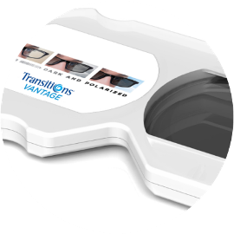
Tools to use
1. Transitions UV demo lamp
2. Transitions Vantage lens in lorgnette holder
3. Glare simulator
Notes:
Once you’ve identified which patients you want to discuss Transitions Vantage lenses with, you will of course want to explain to them what variable polarization is and the benefits of crisper, shaper vision the lenses provide. We’ve developed demonstration tools to help you do this.
The Transitions UV demonstration lamp you may be familiar with. It is an excellent way to demonstrate adaptive lens technology.
A new lens lorgnette and glare simulator will help you show that Transitions Vantage lenses not only darken they also polarize.
Your patients will be able to see the benefits of polarization when they look at the glare simulator through Transitions Vantage lenses.

Slide 38
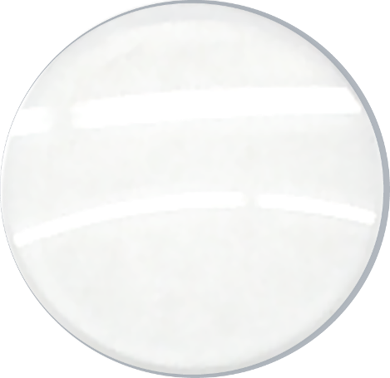
Lens orientation
2D Matrix
Polarization axis
Polar opposite mark
Notes:
Because Transitions Vantage lenses become polarized, your lab will need to orient the lenses correctly in the frame.
The lenses will come from the manufacturer with markings indicating the polarization axis, as you can see in this image … two plus signs.

Slide 39
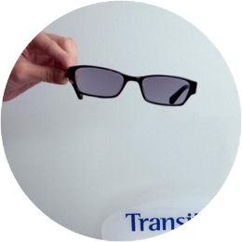
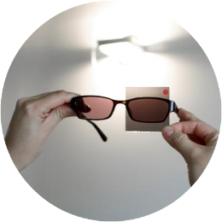
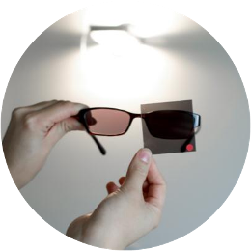
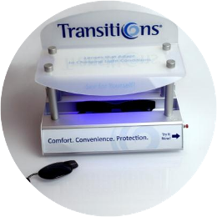
Final inspection
1. Fully activate the lenses
2. Cover with a polarizing film
3. Verify the lenses appear darker
39
Notes:
Once you receive the lens back from the lab, you will want to follow these steps to complete the final inspection of new Transitions Vantage lenses.
First, bring Transitions Vantage lenses to a fully activated state in the new Transitions UV demo unit or by taking them outdoors.
If you are using the UV demonstration unit, it must be the new model (shown), and you must wait for it to run a full activation cycle (for the light to turn off).
When the lens is fully darkened, verify the polarization axis as you would with any polarized lens by covering it with a polarizing film, and verifying the lenses appear darker.
The Transitions Vantage launch kit includes a polarization film (as shown).
Keep in mind that because the level of polarization is variable, the test will not result in total darkness but rather a lens that is darker than without the film.

Slide 40
Product availability in grey color
Check with your lab or lens manufacturer for details
FSV
SFSV
SF PAL
SF Bi-Tri focal
1.5 CR 607
No*
YES
No**
No
Polycarbonate
No*
YES
YES
No
Trivex
No*
YES
YES
No
* Polarization axis combined with the different cylinders axes make the number of SKUs unmanageable
** Refractive index of the Transitions Vantage technology coating similar to CR 607 — making PAL engravings “disappear “
Notes:
Transitions Vantage lenses (will be available after April 1/are currently available) in a grey color in a variety of materials and designs.
Check with your lab or lens manufacturer for details on specific availability.

Slide 41
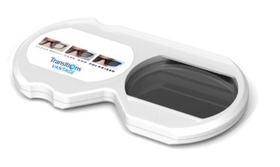
Support materials
Visit www.TransitionsVantage.com
Take the quiz
Get a free launch kit
Notes:
We know that when any new product launches, there are tools you’ll need to help you understand the product and recommend it to your patients.
You can find or order these materials online on www.TransitionsVantage.com.
On that site you can register to take an online quiz, once you receive a 100% (which I am sure you will after today’s presentation) you will qualify to receive a free launch kit

